Slide 1
Seeing Open Access processes more clearly: Mapping the life cycle of open access for publishers, researchers and libraries
R2R Conference
15-16 February 2016
Graham Stone
Collections and Scholarly Communications Librarian

Slide 2
Jisc OA Pathfinders
9 Jisc Open Access Pathfinder projects running June 2014 – May 2016
  http://openaccess.jiscinvolve.org/wp/pathfinder-projects/
Aimed at:
  Recognizing OA work within institutions
  Stimulating collaboration
  Highlighting good practice
  Preparing for the introduction of the HEFCE REF Open Access policy
Other projects are available:
  Ethnographic studies
  Guides for researchers wishing to engage etc.
  Self-assessment tool for researchers

Slide 3
HHuLOA project
Hull, Huddersfield and Lincoln Open Access
Looking at open access from two perspectives
  Getting our house in order so open access processes work
    Capturing work in progress
    Navigating funder policies
    Identifying gaps and putting everything together in a lifecycle
  Exploring how open access links into research development
    Open access lifecycle from different stakeholder perspectives
    Practicalities of how open access can be embedded in research
    Open access and research strategy
Perspective of three institutions with developing research portfolios

Slide 4

What Is OAWAL?
Goal is to produce an openly accessible wiki/blog reference site for librarians working on the management of open access workflows
To contain best practice guidance and charts for research & publishing alignment
Contains international examples
Agnostic regarding the route to OA & level of advocacy
OAWAL wants to promote incorporation with the research & publication process
https://library3.hud.ac.uk/blogs/oawal/
Jill Emery, Portland State
Graham Stone, Huddersfield

Slide 5
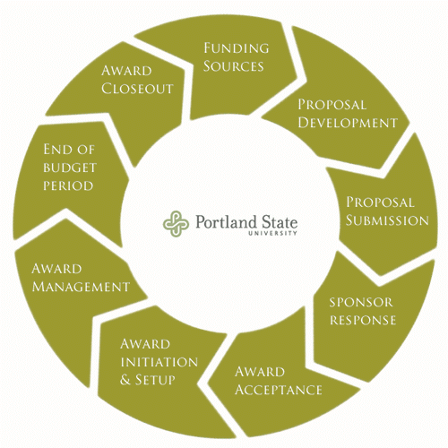
Why the Research Lifecycle?
Important to remember that publication & data are the outputs of research; not the basis for research
Faculty faced with multiple time constraints
Faculty respond more positively when their process is understood
Our timelines are not their timelines
Sponsored Projects Lifecycle from PSU Research Development & Administration https://sites.google.com/a/pdx.edu/research/lifecycle

Slide 6
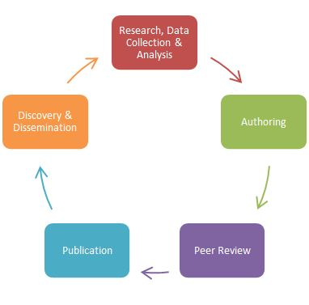
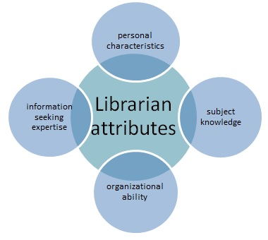
North American Visions
Is it time to re-envision the role of academic librarians in faculty research? Brydges & Clarke, University of Calgary http://libraryconnect.elsevier.com/articles/2015-07/it-time-re-envision-role-academic-librarians-faculty-research#sthash.NcrWdr6x.dpuf
University of Florida George A. Smathers Libraries, Scholarly Communication Home Page: http://cms.uflib.ufl.edu/ScholComm/Index.aspx

Slide 7
The Research Lifecycle
For librarians/repository managers
For research managers
For researchers
For publishers
For the US and UK
https://library3.hud.ac.uk/blogs/hhuloa/2015/12/02/new-oa-life-cycles-for-comment/

Slide 8
The Research Lifecycle
For librarians/repository managers
7 stages of the publishing process as described by Neil Jacobs (Jisc OA Services)
Institutional processes
  Not all institutions will have all processes up and running
Publisher services that directly impact upon the work of the open access team
Above campus services
6 sections of OAWAL

Slide 9
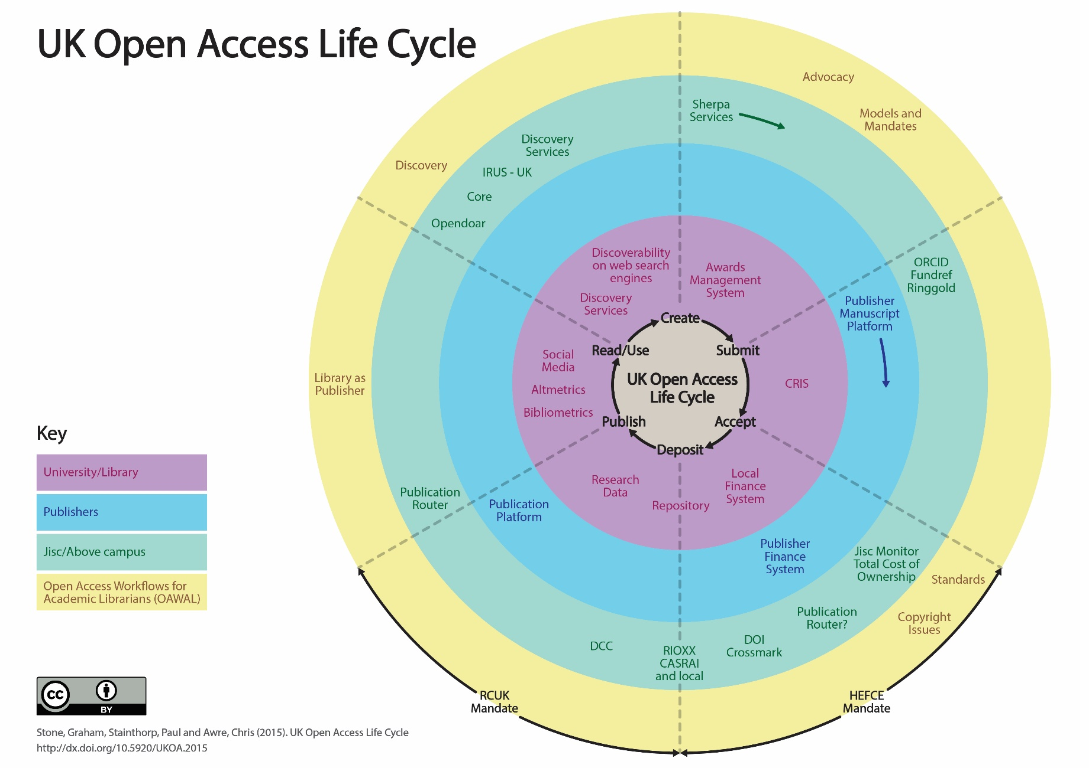

Slide 10
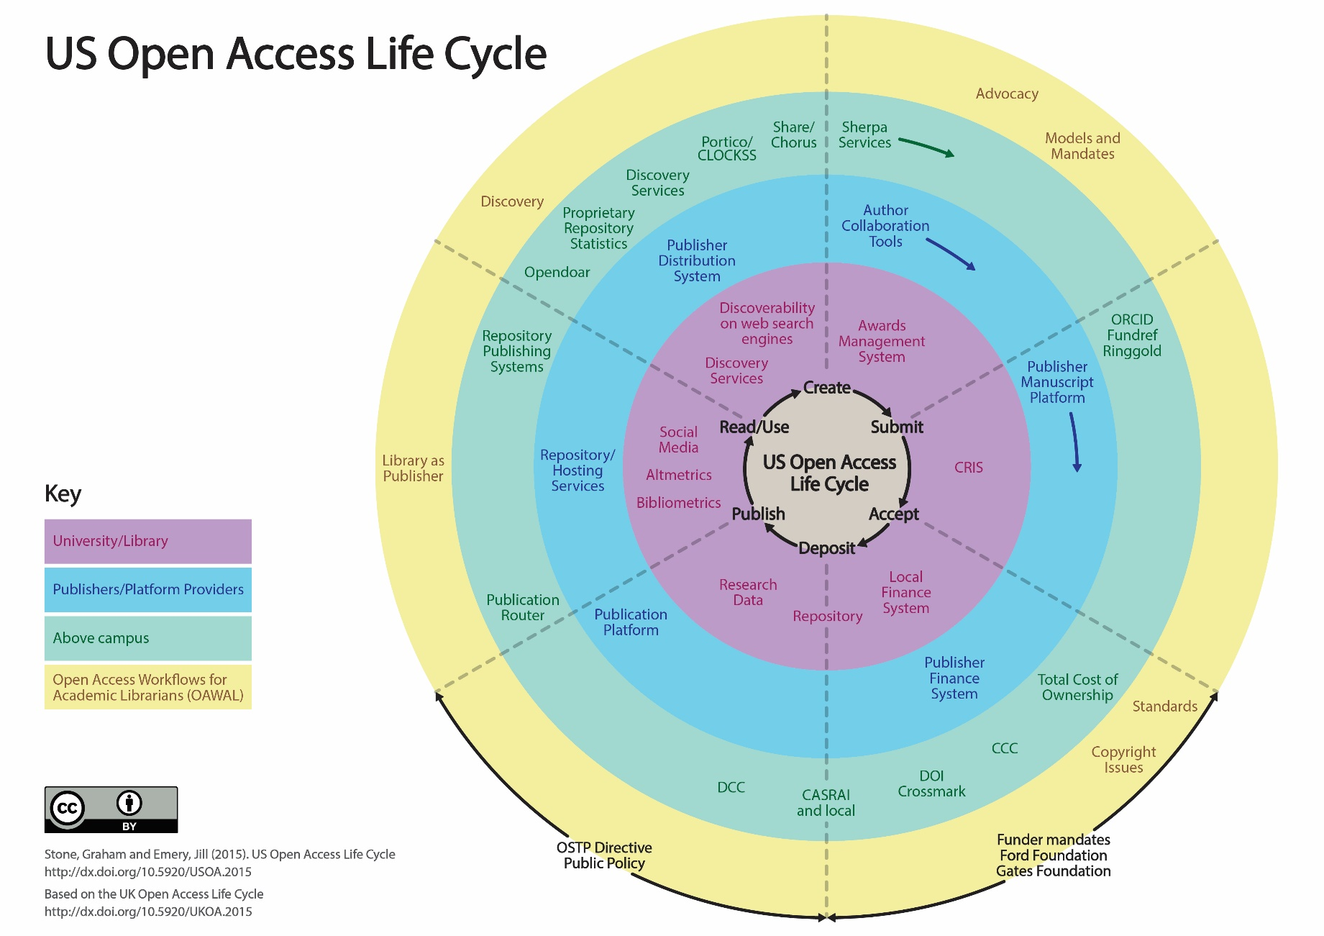

Slide 11
The Research Lifecycle
For research managers
Institutional processes
  Not all institutions will have all processes up and running
Funder liaison/mandates that directly impact upon the work of the open access team
Above campus services
9 stages of the Sponsored Projects Lifecycle

Slide 12
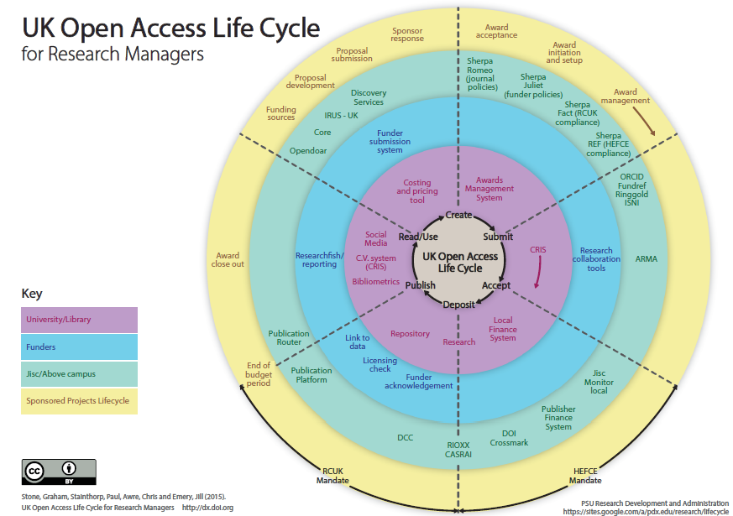

Slide 13
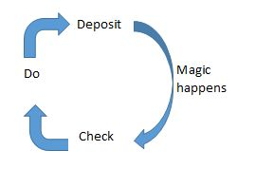
The Research Lifecycle
For researchers

Slide 14
The Research Lifecycle
For researchers
Institutional processes
  Not all institutions will have all processes up and running
Funder liaison/mandates that directly impact upon the work of the open access team
Above campus services
Publisher services that directly impact upon the work of the researchers
6 sections of OAWAL

Slide 15
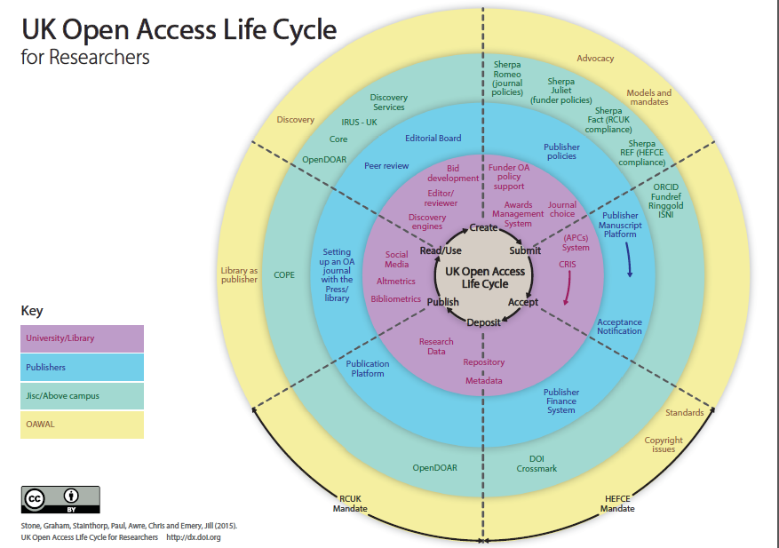

Slide 16
the Research Lifecycle
For publishers
Institutional processes
Funder liaison/mandates that directly impact upon the work of the open access team
Above campus services
6 sections of OAWAL

Slide 17
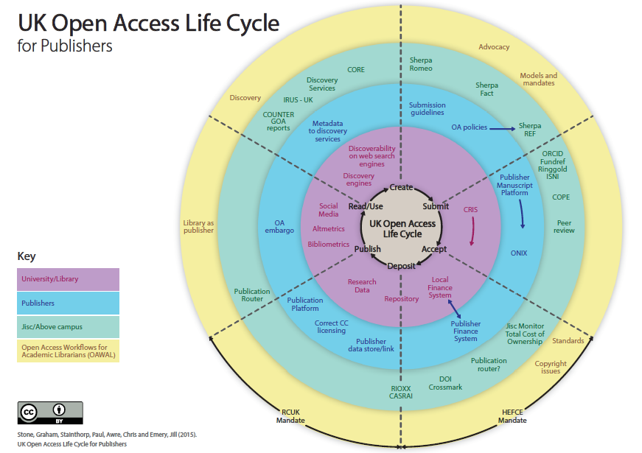

Slide 18

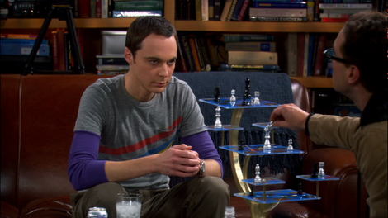
Joining the dots
From this:
To this:

Slide 19
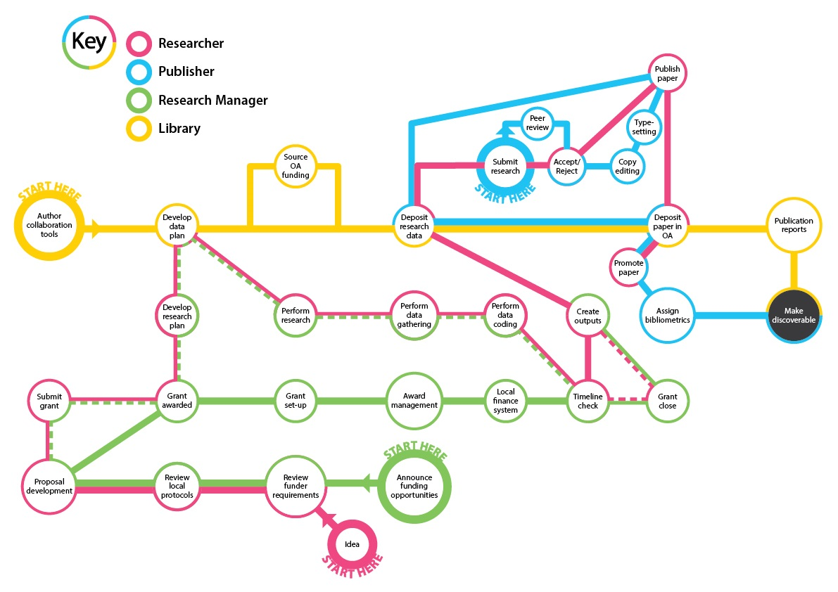

Slide 20
We could all benefit from further dialogue
These are ‘our’ life cycles from a library/research office perspective
What is your perspective?
  Please feedback via the HHuLOA blog: https://library3.hud.ac.uk/blogs/hhuloa/2015/12/02/new-oa-life-cycles-for-comment/
We lack common language and understanding of priorities
The more we share about our open access implementations, the more we can learn from each other

Slide 21

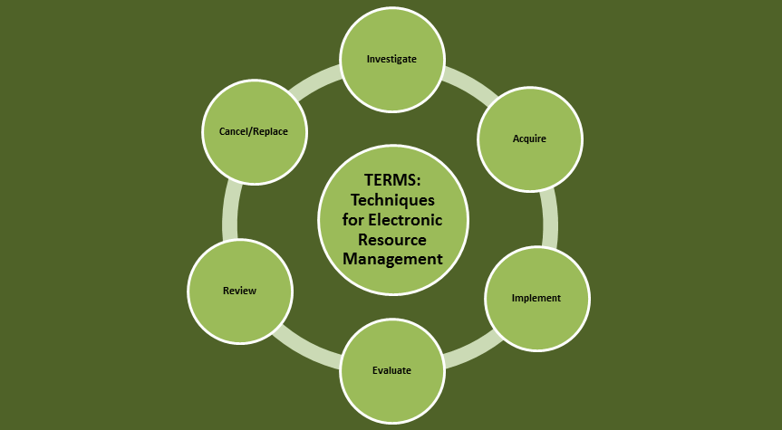
Next steps for HHuLOA
How can we really embed OA?
Can we embed OA into the e-resources management workflow?
  Individual papers, fully open access journals, offset deals
  OA and e-resources are increasingly overlapping, so need to be treated together

Slide 22
Thank you
  https://library3.hud.ac.uk/blogs/hhuloa/
  #hhuloa
  Graham Stone
  g.stone@hud.ac.uk
  @Graham_Stone
http://eprints.hud.ac.uk/26488/
This work is licensed under a Creative Commons Attribution 4.0 Unported License

