Slide 1
Engaging researchers with social media tools:
25 Research Things @ Huddersfield
Graham Stone
Information Resources Manager
This work is licensed under a Creative Commons Attribution 3.0 Unported License

Slide 2
Outline
Introduction
Background
25 Research Things @ Huddersfield
Evaluation
Findings
Looking Forward

Slide 3
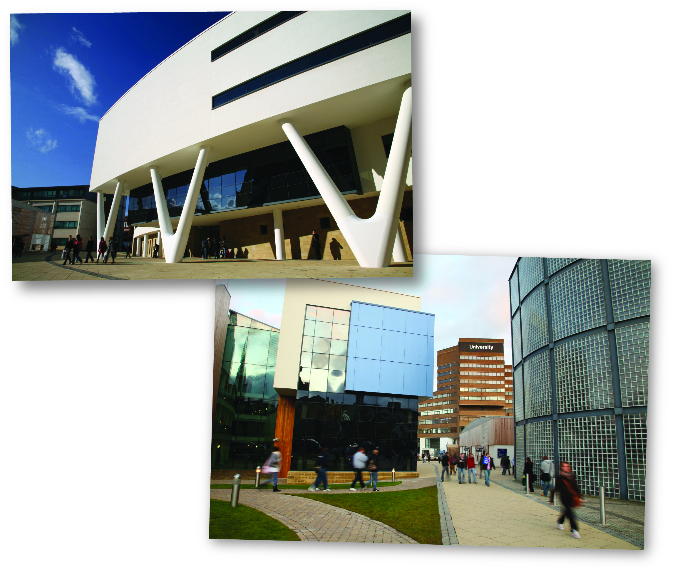
University of Huddersfield - profile
Medium-sized University in the north of England
24,000 students (16,000 FTE); 7,500 p/t
57% female; 68% mature; 19% declared non-white
Broad spread of courses
Increasing international focus
Growing research portfolio

Slide 4
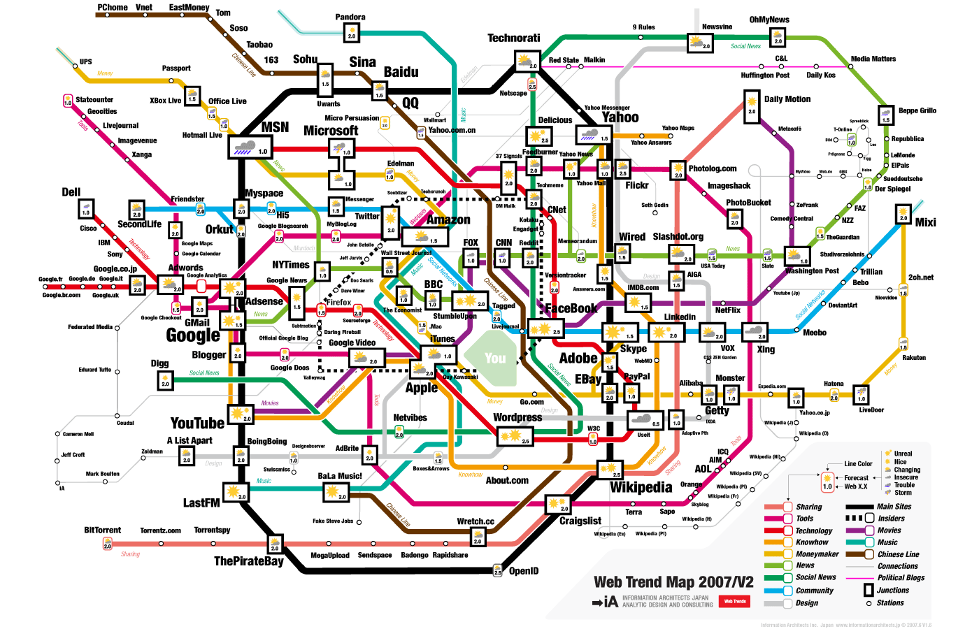

Slide 5
What is Social Media?
“Social media is user generated content that is shared over the internet via technologies that promote engagement, sharing and collaboration”
The Social Media Guide
Notes:
Graham??
Ok so before we get started , I should explain what social media actually is. If you look on the internet for a definition of social media you come up with dozens of different definitions, probably because it’s still an evolving term. This is one of the better definitions that I’ve come across.
Essentially, all social media boils down to online converstation. Just like with offline conversations; there are interesting and relevant ones and there are mundane and pointless ones, unfortunately, social media has a bit of reputation for the later, “it’s just celebrities posting what they had for breakfast” is a common objection to social media. However, if you seek out and engage with the right people using social media, you can have hugely productive conversations.
So, why should you engage with social media, what can social media do for you? In the physical world people take time to build and further their professional reputation and that’s seen as an important part of an academic career. Social media is just another way, a very good way, of furthering your professional reputation. The more you engage and answer questions and pose questions online the more you boost your online profile and raise aware of you your research. There’s ever increasing blur between the physical world and the online world so to have a good reputation online really helps improves your profile offline.
Social media is also a great way of keeping up to date professionally, quite often the conversations happening online are more cutting edge and up to date than the traditional methods of academic communication.
Social media’s most useful attribute is for networking, for meeting new people – and we’ll look a case study specifically about that later.

Slide 6
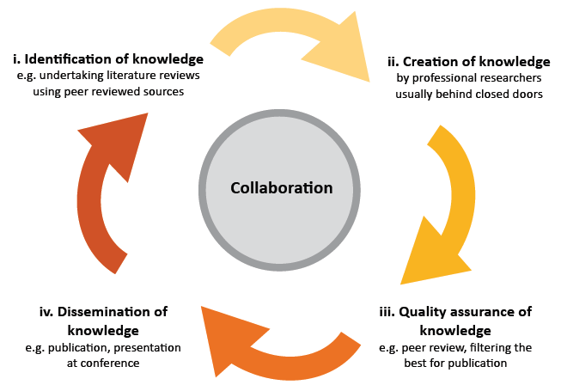
What do social media mean for researchers?
Social Media: A guide for researchers
http://www.rin.ac.uk/our-work/communicating-and-disseminating-research/social-media-guide-researchers

Slide 7
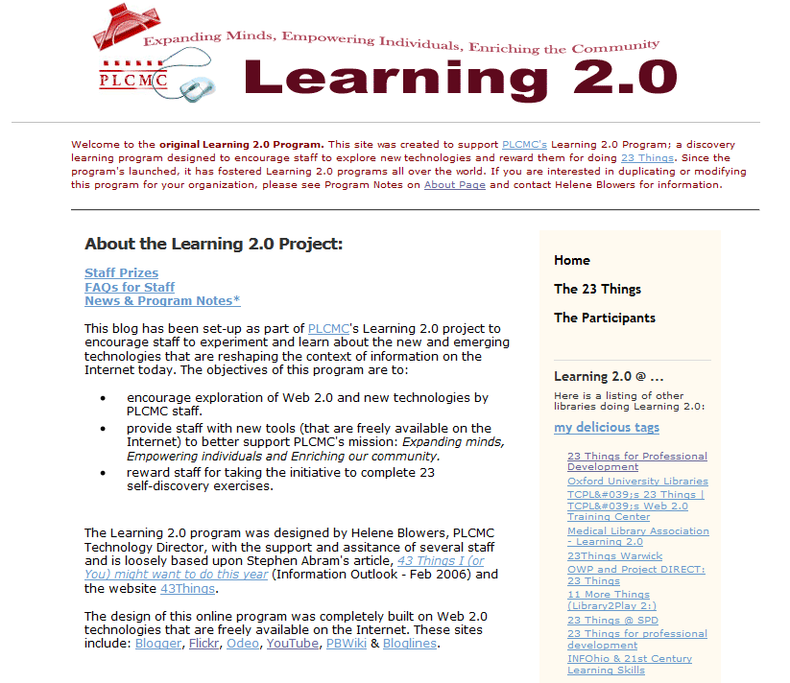
Learning 2.0
Developed by the Public Library of Charlotte and Mecklenburg County
Based upon Abrams’ suggestion that by incremental learning and self-discovery learners could increase their knowledge in small steps
http://plcmcl2-about.blogspot.com/

Slide 8
‘Expanding minds, Empowering individuals and Enriching our community’
Aimed at encouraging public library staff to learn about the new and emerging web 2.0 technologies that many of the public libraries users were already familiar with
Blowers adopted a ‘steal these ideas’ approach by licensing the programme under Creative Commons

Slide 9
Learning 2.0
Around 500 libraries across the world have adapted Learning 2.0
  http://www.delicious.com//hblowers/learning2.0libraries
The University of Huddersfield was one of the first Library 2.0 programmes in UK higher education

Slide 10
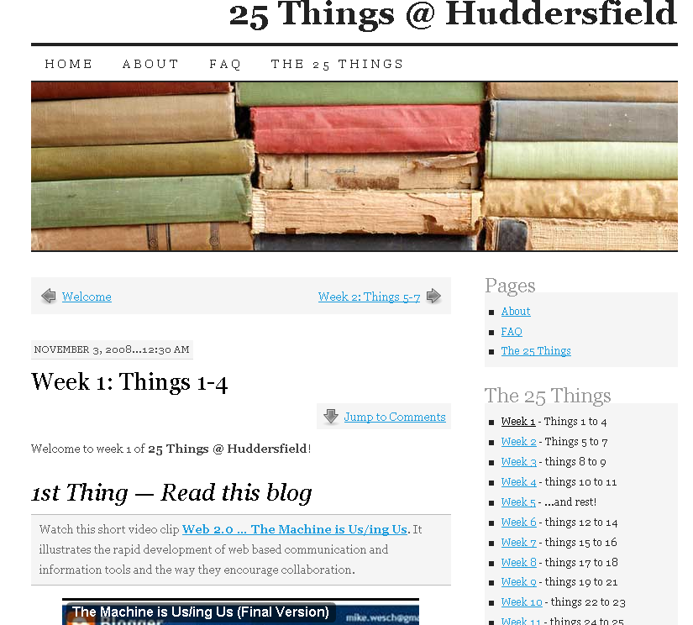
25 Things @ Huddersfield

Slide 11
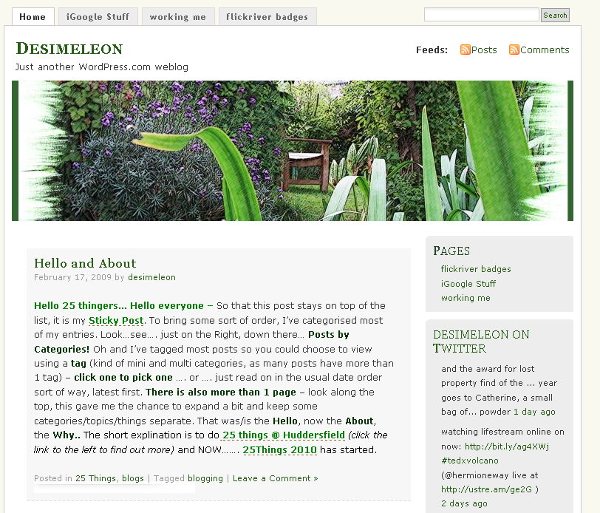
25 Things @ Huddersfield

Slide 12
25 Things @ Huddersfield
25 Things 2008. http://25things2008.wordpress.com/
25 Things 2010. http://25things2010.wordpress.com/
Barrett, Lynn, Evans, Jenny, Harrison, Ruth, Heathcote, Derek, Jones, Lawrence, Osborne, Antony, Pattern, Dave, Stone, Graham and Thompson, Katharine (2009) Getting to know Web 2.0 tools. CILIP update. pp. 40-43. http://eprints.hud.ac.uk/6524/
Stone, Graham (2010) Getting to know Web 2.0: 25 Things the Huddersfield way. In: Do library staff really need to know about this stuff? Developing library staff through emerging technologies, 23 April 2010, Manchester Metropolitan University. (Unpublished). http://eprints.hud.ac.uk/7459/

Slide 13
Researchers use of social media
In 2007, the development of web 2.0 technologies was investigated for JISC (Anderson, 2007)
  http://www.jisc.ac.uk/publications/reports/2007/twweb2.aspx
In conclusion the report posed a number of issues and challenges to UK Higher and Further Education
‘too many researchers see the formal publication of journal and other papers as the main means of communication with each other’

Slide 14


Take up of social media by researchers
Evidence that take up of social media is still restricted to a relatively small group of enthusiasts
Researchers are interested in these new tools, but are not sure how they can be used to best effect
If you build it, will they come? How researchers perceive and use web 2.0
http://www.rin.ac.uk/our-work/communicating-and-disseminating-research/use-and-relevance-web-20-researchers

Slide 15
Implications for University Computing and Information Services
Their roles might usefully include:
  raising awareness of the range of tools and services and their relevance for different kinds of activities;
  publicising examples of successful use and good practice by research groups and networks across a range of disciplines;
  providing guidelines and training to help researchers make informed choices;

Slide 16
Implications for University Computing and Information Services
In 2009 a study found that 54% of librarians see no academic value to social media (Hendrix et al, 2009)
  http://dx.crossref.org/10.3163%2F1536-5050.97.1.008

Slide 17
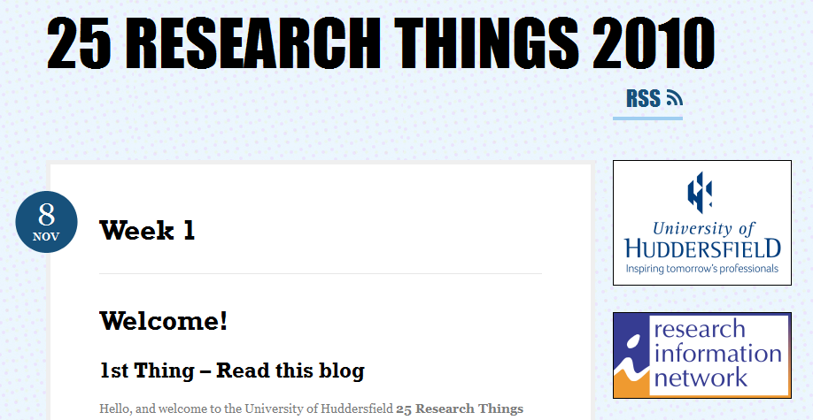
25 Research Things
25 Research Things was the first online course in the UK to follow on from the 23 Things concept in order to specifically engage with researchers about social media tools and technologies

Slide 18
Course objectives
To
  Assist researchers to make sense of the web 2.0 tools and services available to them
  Provide a programme to help researchers interact with web 2.0 tools and technologies
  Assess the level of awareness of web 2.0 tools and technologies in early career postgraduate research students within the University
  Support the University Strategic map by strengthening and enhancing its research capability
  Foster practical implications of the RIN research

Slide 19
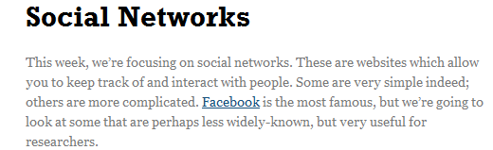
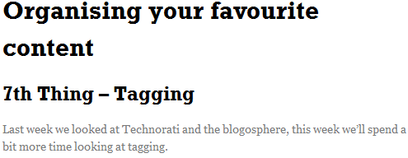
Structure
A number of web 2.0 tools were introduced each week

Slide 20
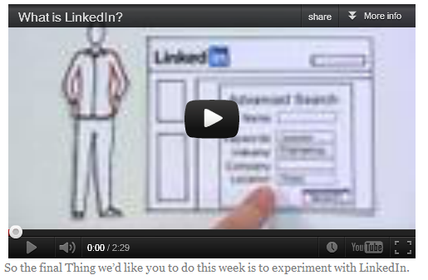
Structure
Each thing was described in an informal way using streaming media and Wikipedia definitions to help explain each concept

Slide 21
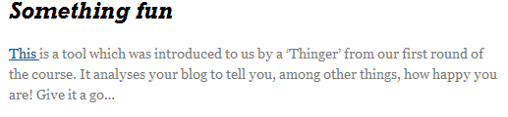
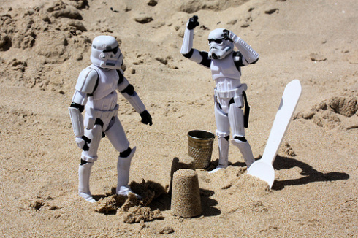
Structure
‘Thingers’ were encouraged to have fun when discovering each thing
http://www.flickr.com/photos/st3f4n/3795266945/

Slide 22
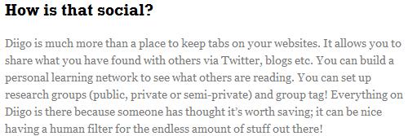
Structure
However, this was then brought back to the research agenda in order to keep the overall focus of the course

Slide 23
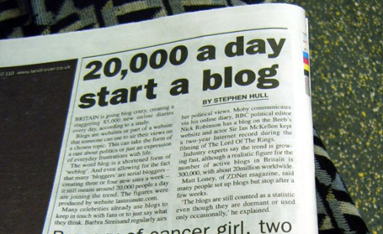

Blogging
All participants established and maintained a blog of their own to report on their experiences with each tool
  Option to do this anonymously
Britain Going Blog Crazy" by Annie Mole on Flickr
http://www.flickr.com/photos/anniemole/85515856
http://www.flickr.com/photos/storrao/4731104536/

Slide 24
Blogging
This approach helped to build a supportive community, with participants commenting on each other’s blogs
Each blog was added to the 25 Research Things blog in the ‘blogroll’ and ‘thingers’ were actively encouraged to read other participants’ blogs and to comment
The project authors were also on hand to help and to post on the blogs too with words of encouragement and support or to enter into some of the discussions

Slide 25
Course contents
Week | Themes | Tool
1 | Survey Blogs | Bristol Online Surveys WordPress
2 | Blogs & RSS Feeds | Technorati Google Reader
3 | Organising your favourite content | Diigo LibraryThing Mendeley CiteULike
4 | Social Networks | Twitter Lanyrd LinkedIn
5 | Sharing content you’ve created | SlideShare Prezi Google Documents Creative Commons
Week | Themes | Tool
5 | Sharing content you’ve created | SlideShare Prezi Google Documents Creative Commons
6 | Images | Flickr Mashups Online Image Generators
7 | Play week | MyExperiment or arts-humanities.net Wikipedia
8 | Audio-Visual | You Tube Podcasts
9 | Reflection | Bristol Online Surveys WordPress

Slide 26
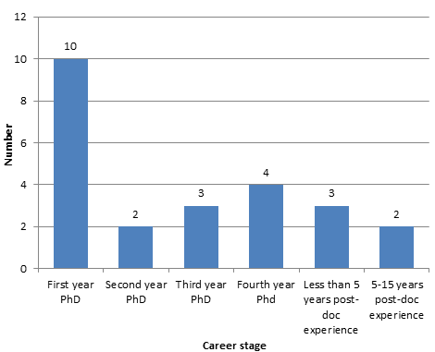
25 Research Things participants
The participants or ‘thingers’ ranged from 1st year PhD students to professors

Slide 27
Evaluation
Two forms of data collection:
  Pre- and post-course questionnaire, run with each cohort of participants
    Not enough post-course questionnaire completions to use in the evaluation
  Also the blogs themselves - participants reflection upon their experiences, behaviours and practices as they explored the new tools and techniques, and expressing this publicly on a blog
    16 researchers created blogs for the first round of 25 Research Things, and 21 did so for the second round

Slide 28
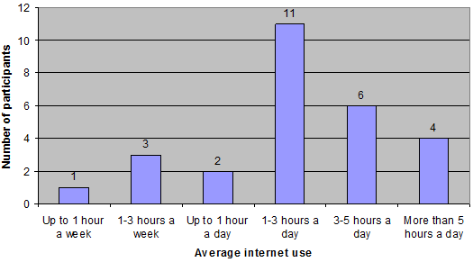
Participants’ average use of internet

Slide 29
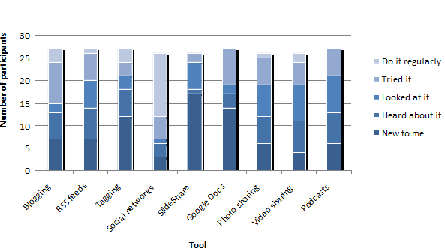
Participants’ experience with specific tools

Slide 30
What motivated them to join?
50% expressed a desire to improve their existing skills and learn more about these technologies
  learning completely new skills, or
  understanding how the tools they use in their social lives might benefit their professional practice, in terms of both research and teaching
Several participants saw these tools as new ways to connect with people -- building professional networks and communicating their research outcomes

Slide 31
What motivated them to join?
Most researchers joined the course to learn something useful, but also to enjoy themselves
We tried to meet these aspirations through our course design
  The primary focus of each ‘thing’ was the tool’s potential research application, but we also showed some lighter-hearted uses
  Comments in the weekly blogs suggest that these ‘fun’ elements were important in keeping participants motivated

Slide 32
Success of the course
The course clearly succeeded in its aim to introduce researchers to new tools and techniques. In some cases, these were tools that they had never used before:
“I really have learned a lot, discovered things I never thought would be useful in my research and signed up to things I probably would never have found myself without this course.”

Slide 33
Success of the course
Researchers had another chance to re-examine (in a more structured way) tools that they had previously experimented with, but had never fully understood or integrated into their research activity:
“It is as if suddenly I have got the hang of the language in a foreign country, and rather than being surrounded with meaningless noise which I simply pass through oblivious I can hear that people are trying to attract my attention.”

Slide 34
Dispelling myths
In several cases, the researchers found that social media tools were more valuable than they had expected:
“I am surprised at the amount of up-to-date material on Wikipedia. Just found a really interesting article in the references as well.”
“I have joined Twitter (which I hate to admit is a lot better than I thought it would be).”

Slide 35
Sharing content
Google Docs was seen as a useful tool for collaboration
“I’m working on a joint grant application with people at another university and I know we are about to get to the problem of version control on the documents we need to prepare…this seems a good way of doing that.”

Slide 36
Applications for teaching and learning
“The format of the blog with tasks linked to other blogs responding to tasks has been really good and I am now just about to replicate this with my teacher trainees. They are due to go out on block placement so we won’t see them for six weeks and we had always intended to set up online activities for them. The platform of choice by default was to be Blackboard but I have chosen to use blogs and going to trial the same model with minor differences in terms of the workload.”

Slide 37
Enabling informed choices
“For me a lot of these ‘tools’ are just distractions. But if I only use two or three of them long term it will be worth it I guess.”
“Twitter (which I still don’t understand by the way, even this course couldn’t change my mind about that).”

Slide 38
Developing a community
“My fellow course members have been great and I’ve enjoyed reading their blogs – some have made me laugh out loud. It’s also shown me how an on-line course can work so well.”
“I have really enjoyed the little community that we have built here and look forward to finding out more about people who work at Hudds Uni, which was one of my aims for the course.”

Slide 39
What could we have done better?
The majority of participants didn’t make it beyond the first couple of weeks; from their blogs, it seems that they struggled with the first few exercises and then gave up
On reflection, the 25 Research Things team lost ‘the educational narrative’ and should have been more visible
Time was another issue - particularly the volume of material each week and the length of the course

Slide 40
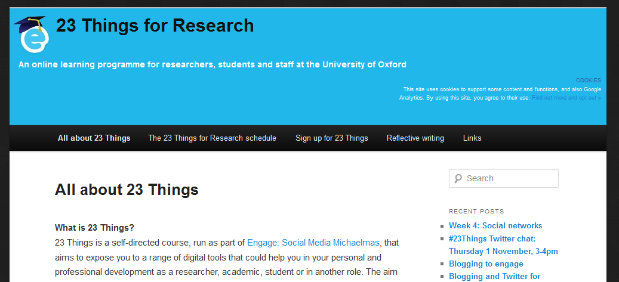
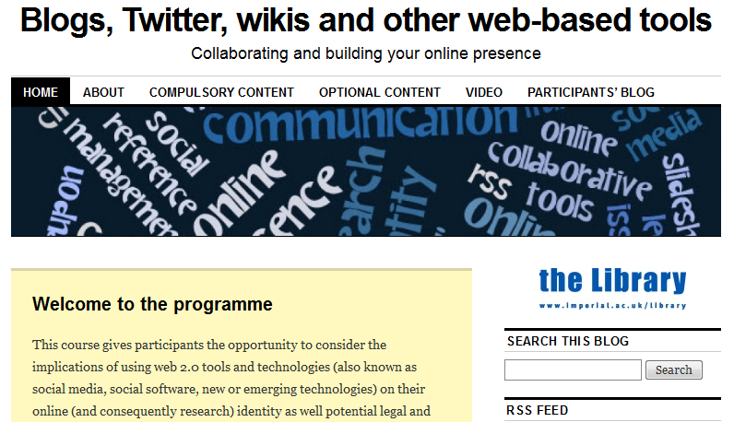
Other programmes

Slide 41
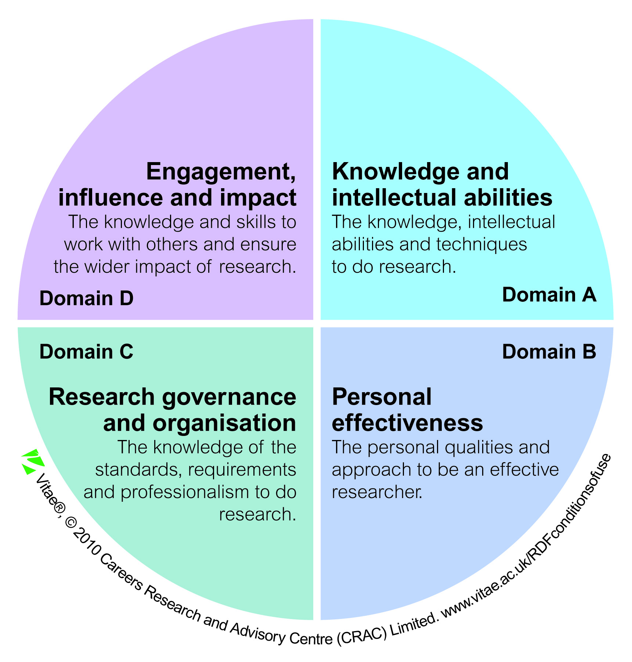

Looking forward
Vitae Research Developer Framework
  http://www.vitae.ac.uk/researchers/428241/Researcher-Development-Framework.html

Slide 42
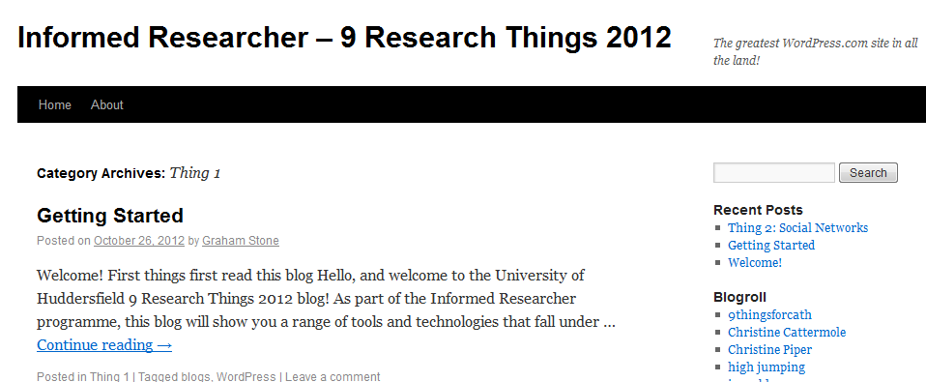
9 Research Things

Slide 43
Programme outline

Slide 44
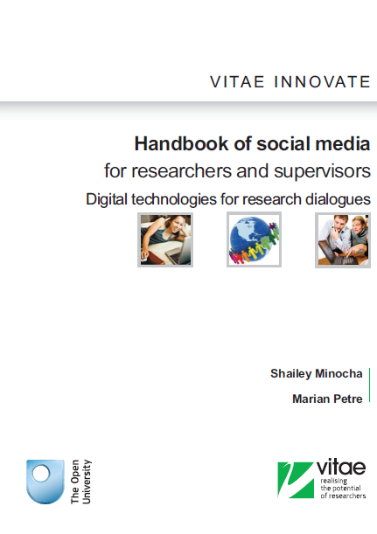
Handbook of social media for researchers and supervisors
Written for postgraduate researchers (PGRs) and early career researchers who want to learn about the role of social media in research dialogues
Some great examples of social media use amongst researchers
http://www.vitae.ac.uk/policy-practice/567271/Handbook-of-social-media-for-researchers-and-supervisors.html

Slide 45
A postgraduate researcher discusses his use of wiki:
“…we use <…> repository to share software code among the project team
and we also use a project wiki to store project documentation i.e. software
code, meeting minutes and presentations, project requirements, outcomes of studies, paper submissions, discussion and decisions in the project
team.”

Slide 46
Increased support
We aim to set aside some time in each of the Informed Researcher workshops throughout the year to discuss any issues that the ‘thingers’ are having with the course
In addition to virtual support and support from other thingers

Slide 47
Thank you!
http://9researchthings2012.wordpress.com/
This presentation
http://eprints.hud.ac.uk/15009/
Graham Stone
g.stone@hud.ac.uk
@Graham_Stone
This work is licensed under a Creative Commons Attribution 3.0 Unported License

